Slide 1
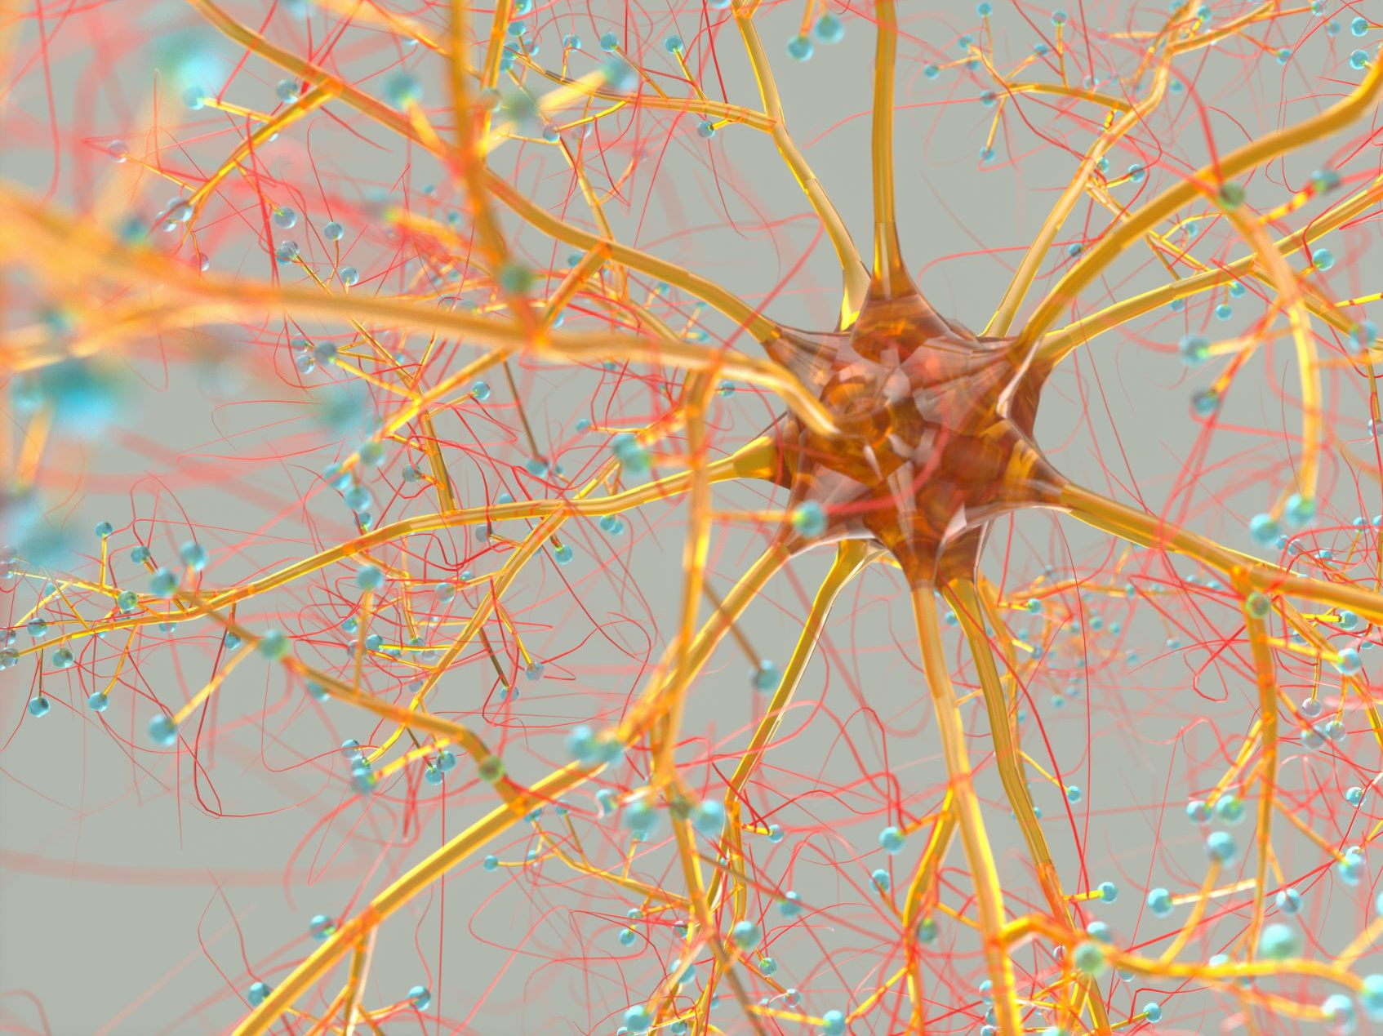
Reinforcement Learning – Teaching Machines to Learn Like Humans
Presented by: Miro Zilaji
Date: 30.4.2025

Slide 2
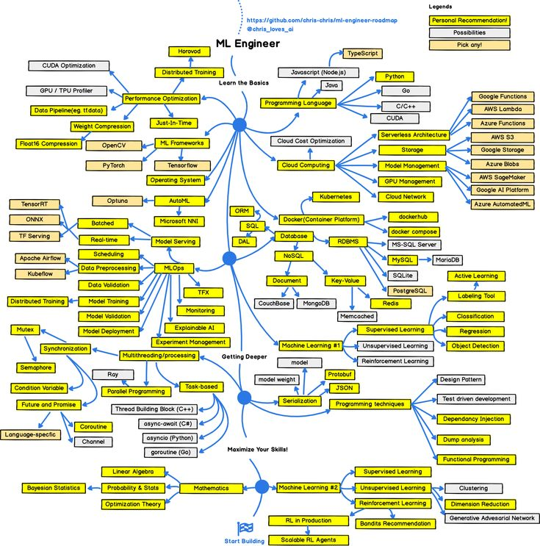
Landscape of ML Engineer field of competence

Slide 3
Structure of the presentation
What is Reinforcement Learning?
When/Where do we use it?
10 Frequent Questions about Reinforcement Learning asked on Job Interviews
Sources

Slide 4
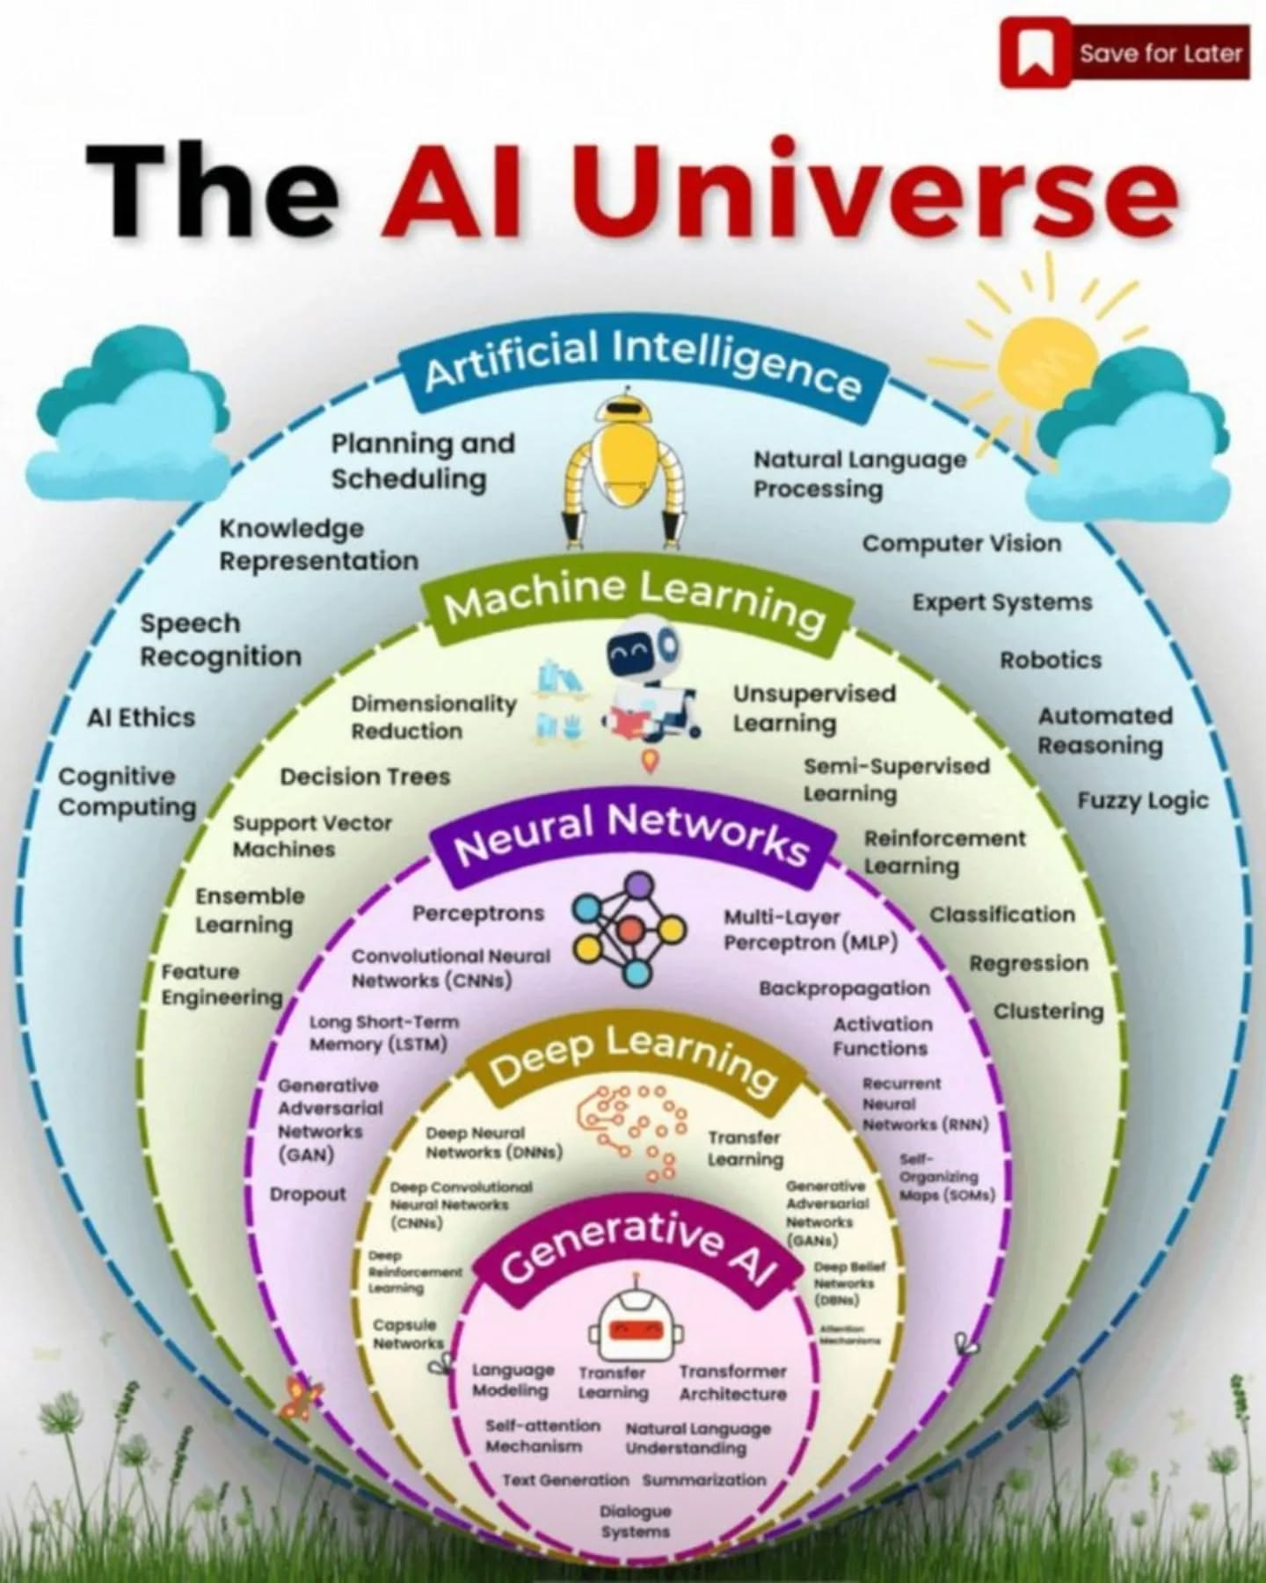
AI Universe

Slide 5
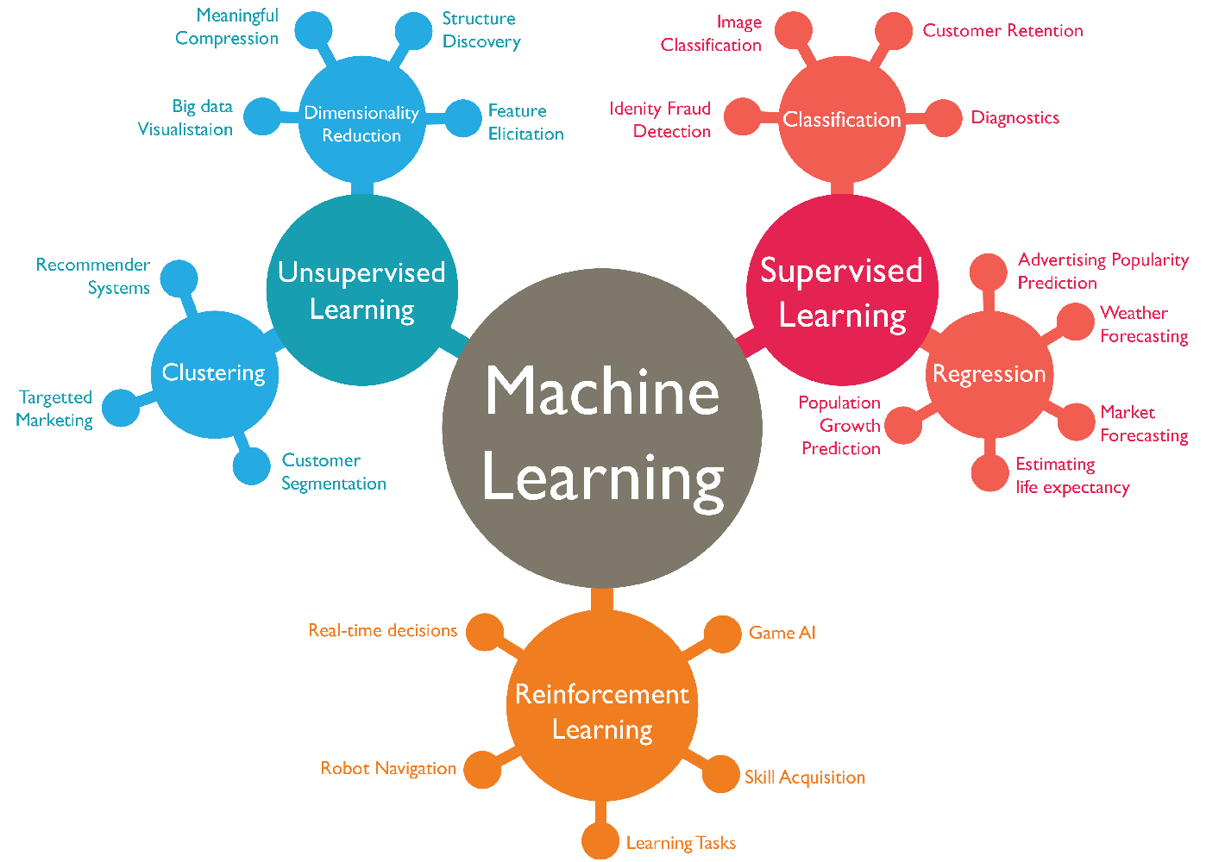
Our Journey through AI Universe – Next Station: Reinforcement Learning

Slide 6
What is Reinforcement Learning?
A type of machine learning
Agent learns by interacting with an environment
Uses trial and error to find the best strategy
Gets feedback through rewards or penalties
A good old „Carrot and Stick“ method

Slide 7
When do we use Reinforcement Learning
We use reinforcement learning when there is no clear correct answer upfront, and the best strategy must be learned through repeated interaction with an environment that provides feedback over time — like in games, robotics, or decision-making systems.

Slide 8

What is Reinforcement Learning?

Slide 9
Real World Examples
Robotics
Task: Teach robots to walk, grasp, or navigate.
Example: Boston Dynamics robots learning balance and movement in real-world environmen
Autonomous Driving
Task: Make real-time driving decisions.
Example: Lane changes, merging, or braking learned through RL in simulation before real-world deployment.
Finance
Task: Optimize trading strategies or portfolio management.
Example: An RL agent learns when to buy/sell stocks based on market signals to maximize returns.
Aerospace & Navigation
Task: Path planning for drones or spacecraft.
Example: RL used in Mars rover simulations to plan efficient exploration routes.

Slide 10
Real World Examples
Healthcare
Task: Personalize treatment plans or drug dosing.
Example: RL models suggest insulin doses for diabetics based on patient data and outcomes.
Gaming & Game AI
Task: Create intelligent, adaptive game agents.
Example: AlphaGo or OpenAI Five learning to beat human players.
Operations & Control Systems
Task: Optimize logistics, manufacturing, or energy systems.
Example: Google DeepMind used RL to reduce cooling costs in data centers by 40%.
Telecommunications
Task: Allocate bandwidth or manage network traffic.
Example: RL agents dynamically optimize mobile network performance during high traffic.
…

Slide 11
Core Concepts/Glosary
Agent: The learner (the dog)
Environment: The world it interacts with (The training area – park,…)
Action: What the agent can do (what does dog do)
State: The current situation (ex. Dog is standing)
Reward: Positive or negative feedback (a treat if dog performs the task)
Policy - The dog’s strategy — sit when it hears "Sit!“
Episode – one training attempt
Goal – for dog to learn to maximize treats by responding correctly

Slide 12

The Reinforcement Learning Loop

Slide 13

Popular RL Algorithms
Algorithm | What It Learns | How It Works | Best For | Real-World Use
🎯 Q-Learning | Action values (Q-table) | Tries actions, updates value table | Small, simple environments | Grid-based games, maze-solving robots
🧠 Deep Q-Network (DQN) | Action values via a neural net | Replaces table with deep learning | Complex/high-dimensional states | Playing Atari games, recommendation systems
📈 Policy Gradient | The policy directly | Learns probability of actions that do well | Continuous or large action spaces | Robotic control, real-time bidding in ads
🎭 Actor-Critic | Policy + value function | Actor chooses actions, Critic scores them | Balance between PG and value-based | Navigation for drones, portfolio optimization

Slide 14
Challenges in RL
🔄 Balancing exploration vs exploitation
What it means: Should the agent try something new (explore) or stick with what has worked so far (exploit)?
Example: In a food delivery app, should it keep offering the most popular dish (exploit) or try suggesting a new dish that might become a hit (explore)?
⏳ Delayed rewards
What it means: The agent's actions may only pay off after many steps, not immediately.
Example: In chess, a move you make now might not give you a reward until many moves later when you win or lose. The system must learn to link early decisions with much later outcomes.

Slide 15
Challenges in RL
🧭 Sparse rewards
What it means: The agent rarely gets feedback, so it’s hard to learn what works.
Example: A robot in a maze only gets a reward when it finds the exit. But while wandering around, it gets no hints — just silence. Learning becomes very slow.
🧠 Computationally heavy
What it means: RL needs lots of data, memory, and computation, especially with complex environments.
Example: Training an AI to play a 3D game (like Minecraft) with RL takes millions of simulations, each needing time and processing power — much more than supervised learning.

Slide 16
Visual Examples
CartPole Ballancing:
https://youtu.be/ErqF0S4qtos?si=Alt4BW6oTN54z8VF
Maze
https://www.youtube.com/watch?v=eCWR8mgMFlQ
Frozen Lake
https://youtu.be/59ZNbve8NSc?si=6n04KGzRHR2WlqPO

Slide 17
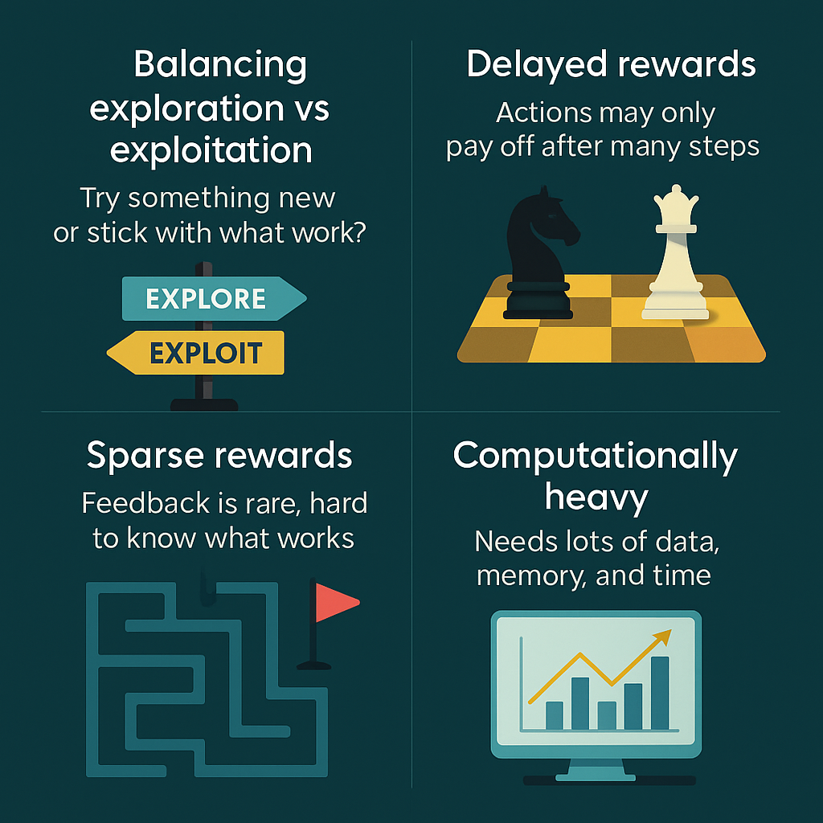
For visual Learners

Slide 18
The Future of RL
🔄 Always Learning AI AI that keeps learning and improving over time — like a personal assistant that gets better the more you use it.
🤖 Smarter Robots Robots that can adapt and make decisions on their own — useful for factories, hospitals, or homes.
🎯 Personalized AI for You AI that tailors itself to your habits and needs — from shopping recommendations to smart home systems.
🧠 Real-Time Decision Making AI that learns strategies as things happen — like managing traffic flow or making moves in a video game.

Slide 19
10 Frequent Questions about R/L on job interviews
1. What is reinforcement learning, and how is it different from supervised and unsupervised learning?
Answer: Reinforcement Learning (RL) is a type of machine learning where an agent learns to make decisions by interacting with an environment to maximize cumulative reward.
Unlike supervised learning, there is no labeled input/output pair; feedback is given in terms of rewards.
Unlike unsupervised learning, which focuses on finding structure in data, RL is goal-oriented and involves decision-making over time.

Slide 20
10 Frequent Questions about R/L on job interviews
2. Explain the key components of a reinforcement learning problem (agent, environment, state, action, reward).
Answer:
Agent: Learner or decision-maker.
Environment: Everything the agent interacts with.
State (S): A representation of the current situation.
Action (A): What the agent can do.
Reward (R): Feedback from the environment based on the action. The agent observes a state, takes an action, receives a reward, and transitions to a new state.

Slide 21
10 Frequent Questions about R/L on job interviews
3. What is the exploration vs. exploitation trade-off in RL? Why is it important?
Answer:
Exploration means trying new actions to discover their effects.
Exploitation means choosing known actions that yield the highest reward. The trade-off is important because focusing only on exploitation might miss better options, while too much exploration delays learning. Balancing both is key to learning an optimal policy.

Slide 22
10 Frequent Questions about R/L on job interviews
4. Can you describe the difference between policy-based and value-based methods in RL?
Answer:
Value-based methods (like Q-learning) learn the value of actions or states and derive a policy from them.
Policy-based methods (like REINFORCE) directly learn the policy without explicitly estimating values. Value-based is more common in discrete action spaces; policy-based is often used in continuous action spaces.

Slide 23
10 Frequent Questions about R/L on job interviews
5. What is a Markov Decision Process (MDP), and why is it important in RL?
Answer: An MDP is a mathematical framework used to model decision-making, defined by:
States (S),
Actions (A),
Transition probabilities (P),
Rewards (R),
Discount factor (γ). The Markov property assumes the future is independent of the past given the present state. MDPs provide the formal basis for most RL algorithms.

Slide 24
10 Frequent Questions about R/L on job interviews
6. What is Q-learning, and how does it work?
Answer: Q-learning is a value-based off-policy RL algorithm. It learns a Q-function: Q(s, a) estimates the expected cumulative reward of taking action a in state s and following the optimal policy afterward. The core update rule is: Q(s, a) ← Q(s, a) + α[r + γ·max(Q(s', a')) – Q(s, a)]

Slide 25
10 Frequent Questions about R/L on job interviews
6. What is Q-learning, and how does it work?
Answer: Q-learning is a value-based off-policy RL algorithm. It learns a Q-function: Q(s, a) estimates the expected cumulative reward of taking action a in state s and following the optimal policy afterward. The core update rule is: Q(s, a) ← Q(s, a) + α[r + γ·max(Q(s', a')) – Q(s, a)]

Slide 26
10 Frequent Questions about R/L on job interviews
7. What is the difference between Monte Carlo methods and Temporal-Difference (TD) learning?
Answer:
Monte Carlo (MC): Waits until the end of an episode to calculate returns, then updates values.
TD Learning: Updates estimates after every step using bootstrapping (i.e., uses existing estimates to update others). TD is more sample-efficient and works in ongoing tasks (not just episodic ones).

Slide 27
10 Frequent Questions about R/L on job interviews
8. Have you heard of Deep Q-Networks (DQNs)? What problem do they solve compared to basic Q-learning?
Answer: Yes! DQNs use a neural network to approximate the Q-function when the state space is large or continuous. They solve the problem of storing and updating a Q-table, which becomes impractical in complex environments. Techniques like experience replay and target networks help stabilize training.

Slide 28
10 Frequent Questions about R/L on job interviews
9. How would you approach designing a reward function for a simple RL task like training an agent to balance a cart-pole?
Answer: The reward function should encourage the agent to keep the pole balanced and cart centered. A simple approach:
Give +1 reward for every timestep the pole is upright.
Optionally, penalize large deviations from center or angle. Keep it dense and consistent to help the agent learn effectively.

Slide 29
10 Frequent Questions about R/L on job interviews
10. What challenges can arise in reinforcement learning, such as sparse rewards or convergence issues? How might you address them?
Answer: Common challenges:
Sparse rewards: The agent rarely gets feedback, making learning slow.
Solution: Use reward shaping or curriculum learning.
Convergence issues: The agent may not learn an optimal policy.
Solution: Use stable algorithms (like DQN with target networks), proper tuning, or better exploration strategies.
Overfitting to the training environment.
Solution: Add randomness, test on multiple scenarios.

Slide 30
Sources
Interview questions: https://www.mlstack.cafe/interview-questions/reinforcement-learning
https://hellointern.in/blog/top-interview-questions-and-answers-for-reinforcement-learning-57425
Reinforcement Learning:
https://youtu.be/8JVRbHAVCws?si=BjqXxh11Ni6u0fft

Slide 31
Questions? 🤔
🔹 Thank you for your attention! 🚀

